Slide 1
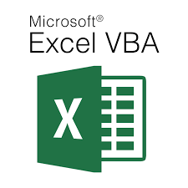
Visual Basic for Application - Theoretical (Lecture 1)
Written By: Kim M Pambid
Reference:
https://learn.microsoft.com/en-us/
https://www.wallstreetmojo.com/
https://www.automateexcel.com/
https://stackoverflow.com/
https://www.wikipedia.org/
https://www.techonthenet.com/

Slide 2
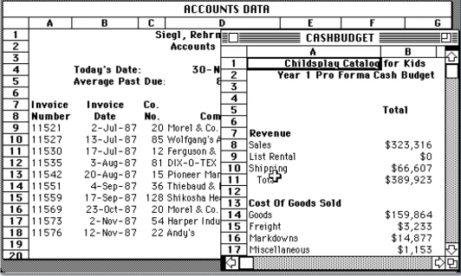
Introduction:
Microsoft Excel is a spreadsheet application launched by Microsoft Corporation in 1985. Excel is a common spreadsheet system that organizes data into columns and rows that can be changed using formulae, allowing the software to perform mathematical functions on the data.
Visual
BASIC
B - Beginners , A – All Purpose, S – Symbolic, I – Instruction, C - Code
To automate excel task Visual Basic for Application(VBA) was introduced on 1993

Slide 3
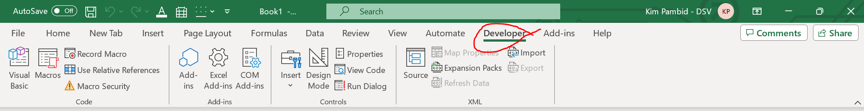
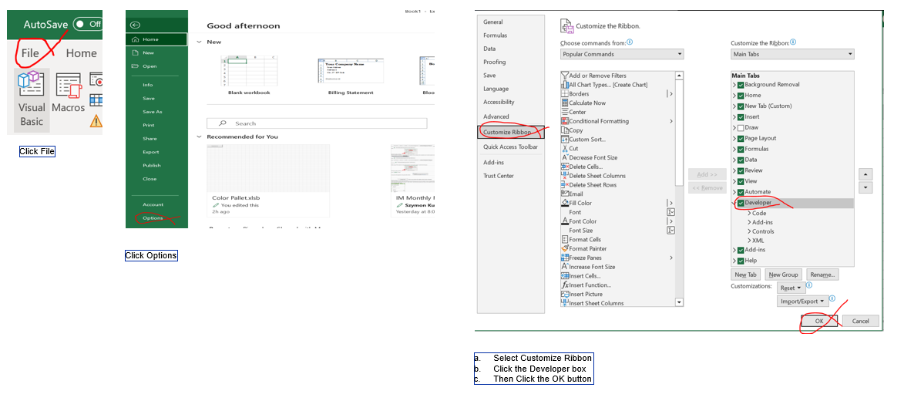
Vba Code Editor
Setting the VBA Developer Option on your excel

Slide 4
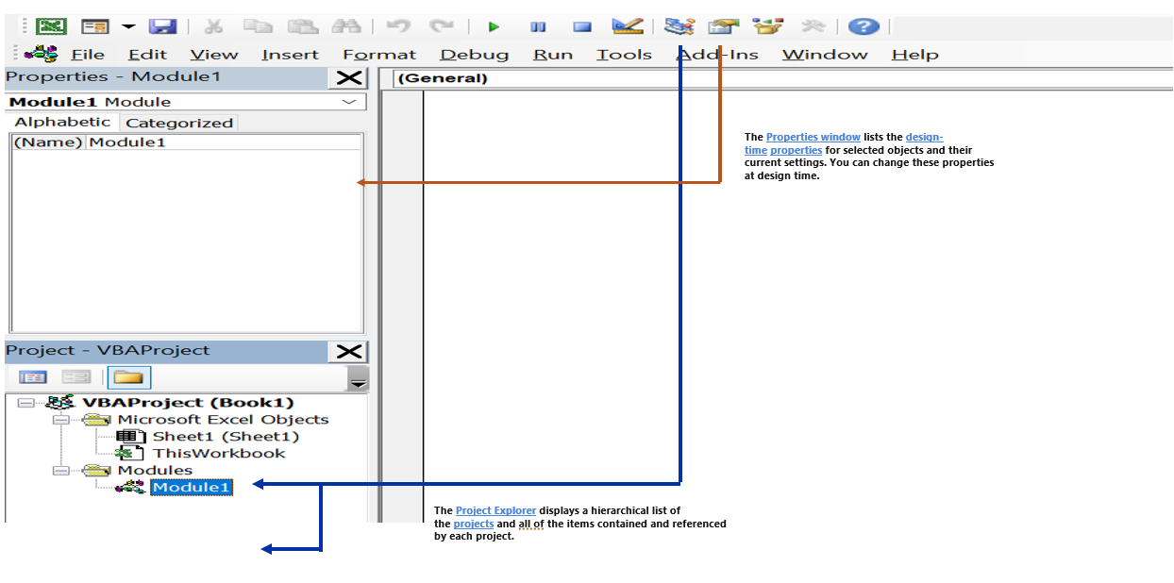
A. Code Editor

Slide 5
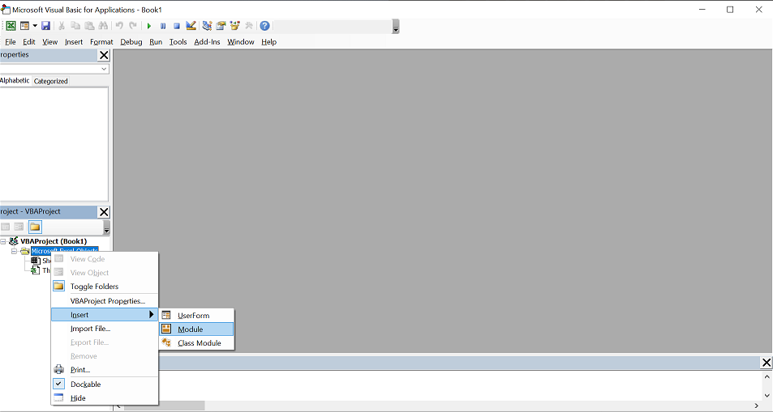
B. Project Explorer
Project Sheet Name – Use for naming modules and classes
Programming Standard in naming a module / class (It is required to right-click the Microsoft Excel Objects.)

Slide 6
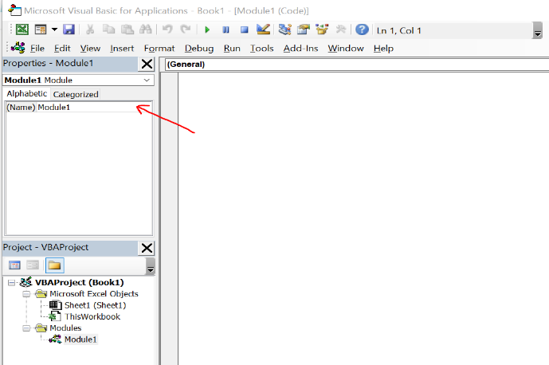
The module's name should reflect its method or procedure.
Example: We are developing a script that is concerned with modifying and formatting text.
Naming style:
Camel Case: module/script name >> TextAlteration
Type your module/script name into the red arrow display below.

Slide 7
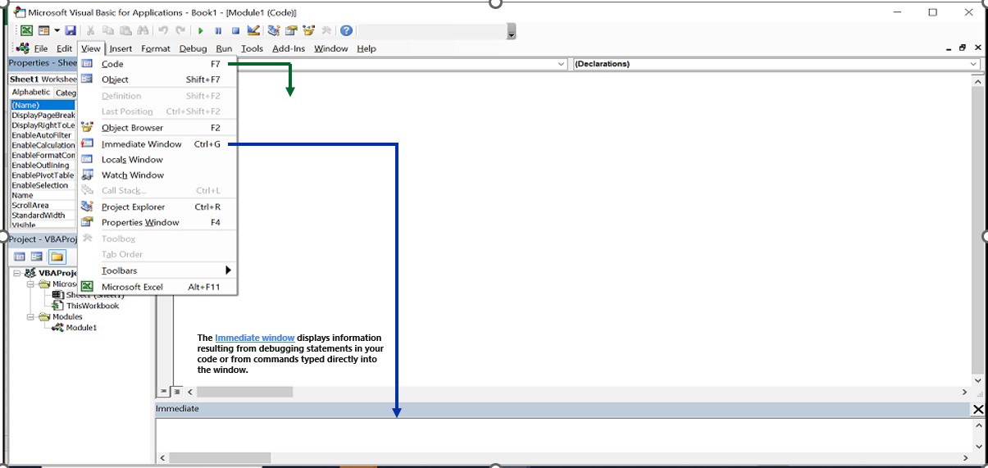
C. View
Immediate Window: To show the worth of an occurrence; Type Debug.Print(“Your Variable or Message”)

Slide 8
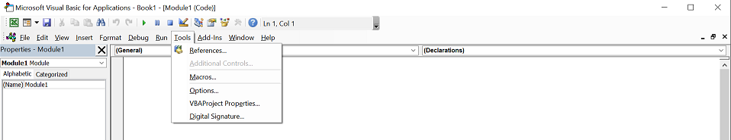
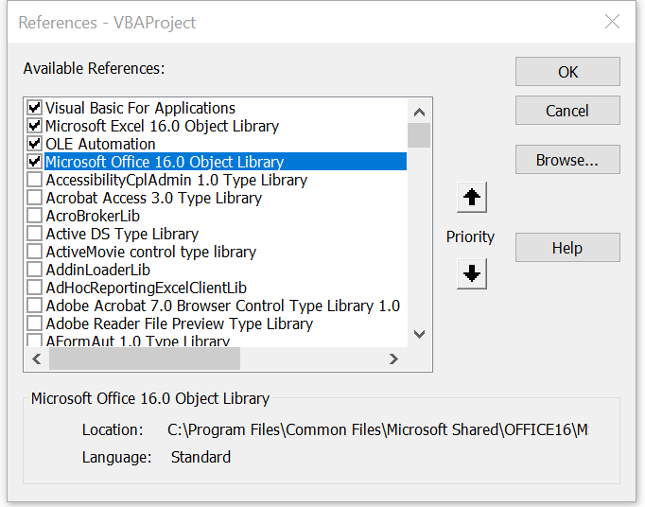
D. Tools
This menu contains commands for accessing additional references and user options.
References - Displays the References dialog box. Allows you to select another application’s
objects that you want available in your code by setting a reference to that application's object library.

Slide 9
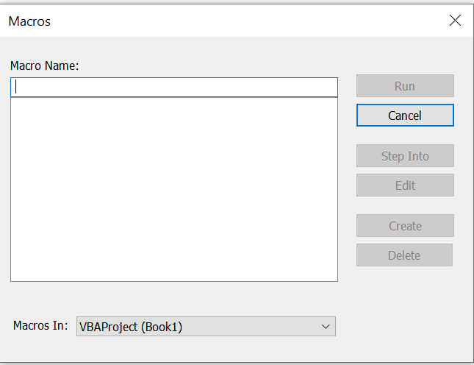
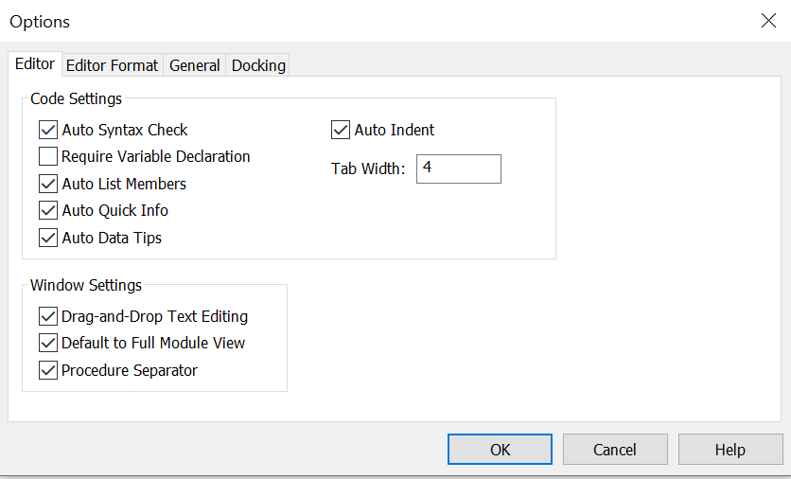
Additional Controls - Displays the Additional Controls dialog box
where you can add controls or insertable objects (such as a Microsoft Word Document).
Macros - Displays the Macros dialog box. Allows you to run, edit, or delete the selected macro.
Options - Displays the Options dialog box.

Slide 10
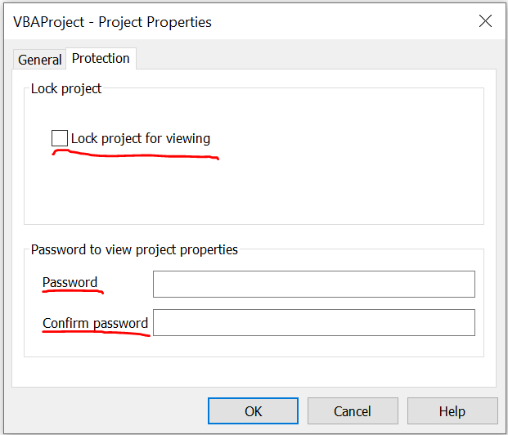
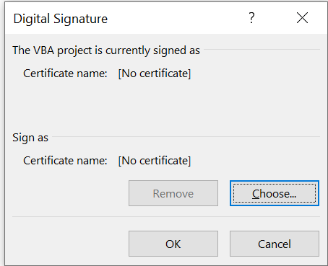
VBAProject Properties - Displays the VBAProject dialog box.
Prevent other users from reading and altering your script.
Digital Signature - Displays the Digital Signature dialog box.

Slide 11
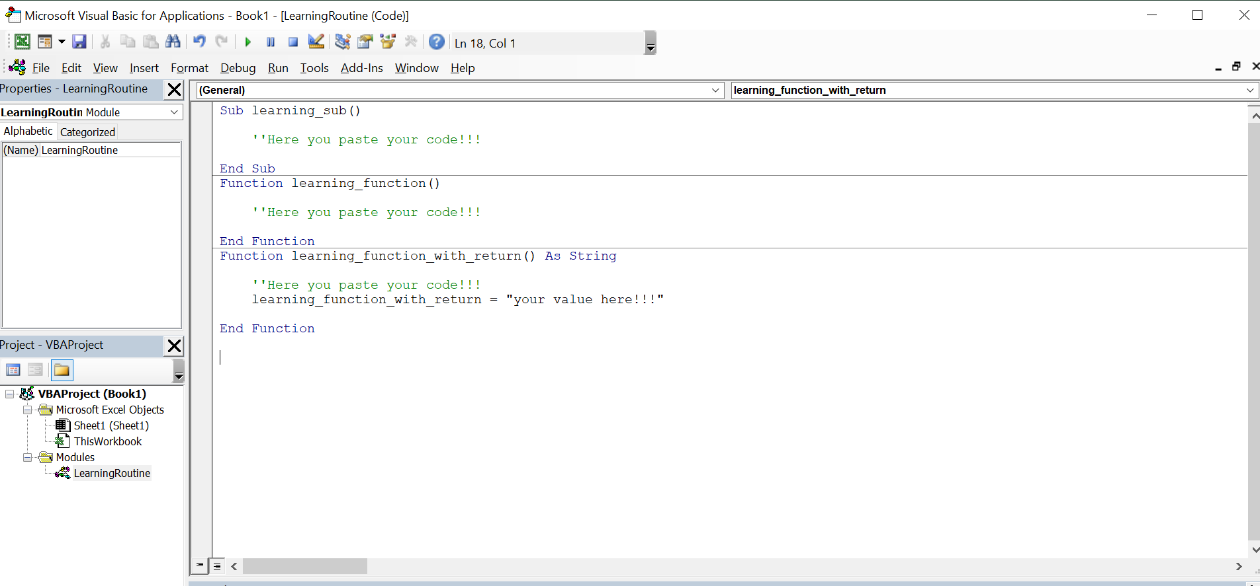
E. Module
VBA module is a “.bcf” / “.bas” extension file that holds the code in the visual basic editor. Each module has its own code window where you can write. You can insert a new module, delete, backup, and import it. In simple words, it’s like a text file that you open in the notepad.
A sub performs a task but does not return a value.
A function returns a value of the tasks performed.
Subs can be recalled from anywhere in the program and in multiple types.
Functions are called by a variable.
Reference: https://learn.microsoft.com/en-us/dotnet/visual-basic/programming-guide/language-features/procedures/sub-procedures

Slide 12
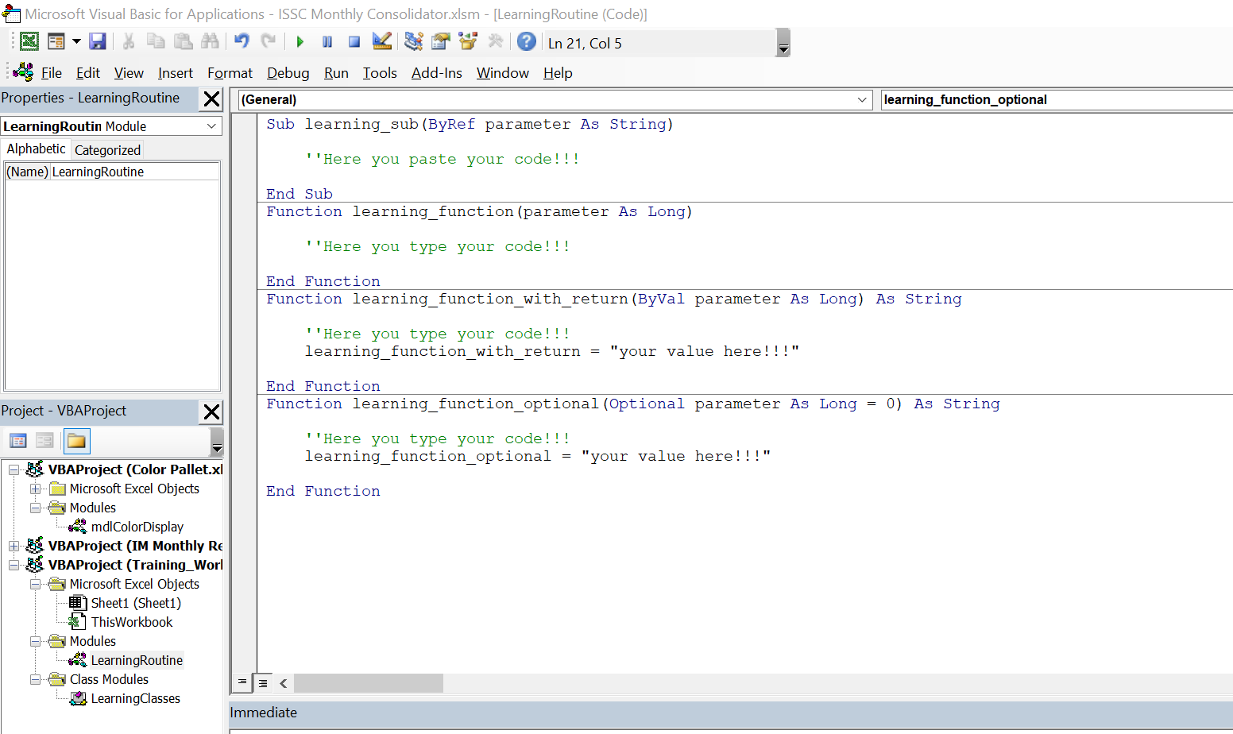
F. Class
In VBA, a class is defined in class module and serves as a template for an object. The term object is deliberately vague.
An object can be defined to represent whatever you want. Anything that you can describe conceptually can be represented by a class.
Optional Arguments
These are arguments that the user can supply if they want, but if they are omitted, the procedure will assign a default value to them.

Slide 13
G. Passing Arguments By Value and By Reference
When arguments are passed to VBA procedures, they can be passed in two ways:
ByVal - The argument is passed by Value. This means that just the value (i.e. a copy of the argument) is passed to the procedure and therefore,
any changes that are made to the argument inside the procedure will be lost when the procedure is exited.
ByRef - The argument is passed by Reference. This means that the address of the argument is passed to the procedure.
Any changes that are made to the argument inside the procedure will be remembered when the procedure is exited.
H. Data Type
Facts about bytes(1 & 0) to be transform to numbers and letters
Binaries: https://www.ime.usp.br/~pf/algorithms/chapters/bytes.html
Hexadecimal: https://www.wikihow.com/Convert-Binary-to-Hexadecimal
Data Type Size and Range: https://learn.microsoft.com/en-us/office/vba/language/reference/user-interface-help/data-type-summary
A data type is the characteristic of a variable that determines what kind of data it can hold.
Data types include those in the following table as well as user-defined types and specific types of objects.
String - A sequence of characters, such as letters, numbers, symbols, or a combination thereof.
SIZE: 10 bytes + string length RANGE: 0 to approximately 2 billion

Slide 14
Integer - A data type we assign to the variables. It is a numerical data type that can hold whole numbers without decimal positions.
SIZE: 2 bytes RANGE: -32,768 to 32,767
Long – A data type to contain integer numbers that are too large to fit in the Integer data type.
SIZE: 4 bytes RANGE: -2,147,483,648 to 2,147,483,647
Double – A data type provides the largest and smallest possible magnitudes for a number.
SIZE: 8 bytes RANGE: -1.79769313486231E308 to -4.94065645841247E-324 for negative values
4.94065645841247E-324 to 1.79769313486232E308 for positive values
Objective - A data type that can also refer to data of any value type (numeric, Boolean, Char, Date, structure, or enumeration)
SIZE: 4 bytes RANGE: Any Object reference
Variant – A data type is automatically specified if you don't specify a data type when you declare a constant, variable, or argument.
SIZE: 16 bytes RANGE: Any numeric value up to the range of a Double
SIZE: 22 bytes + string length (24 bytes on 64-bit systems) RANGE: Same range as for variable-length String

Slide 15
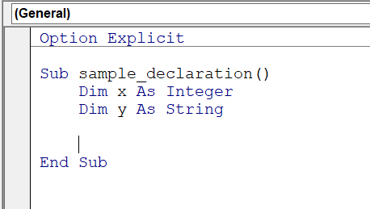
Array – A data type allows you to store multiple values of the same type under a single variable name. These values are stored in contiguous memory locations, and each value is accessed by its index or position within the array.
SIZE: 20 bytes of memory plus 4 bytes for each array dimension plus the number of bytes occupied by the data itself.
RANGE: The memory occupied by the data can be calculated by multiplying the number of data elements by the size of each element.
Boolean – Holds values that can be only True or False
SIZE: 20 bytes of memory plus 4 bytes for each array dimension plus the number of bytes occupied by the data itself.
RANGE: The memory occupied by the data can be calculated by multiplying the number of data elements by the size of each element.
I. Option Explicit
Is a statement that you can use at the beginning of a module to force yourself to declare all the variables.

Slide 16
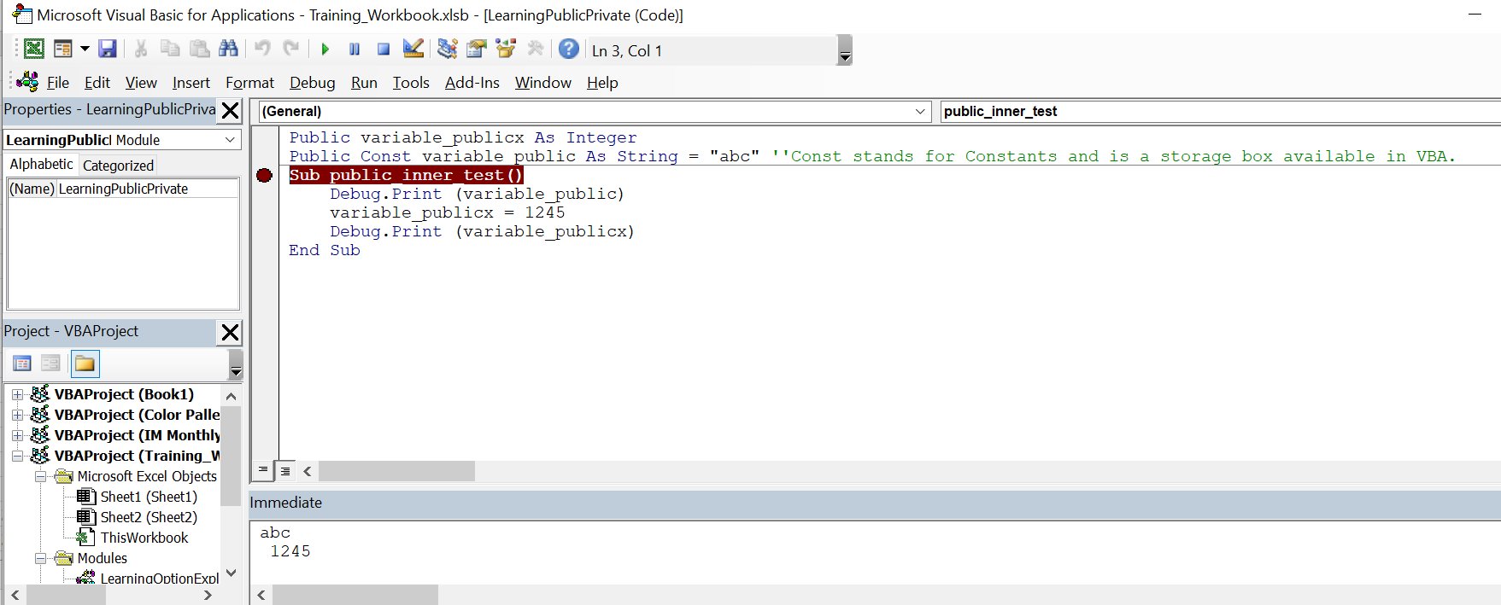
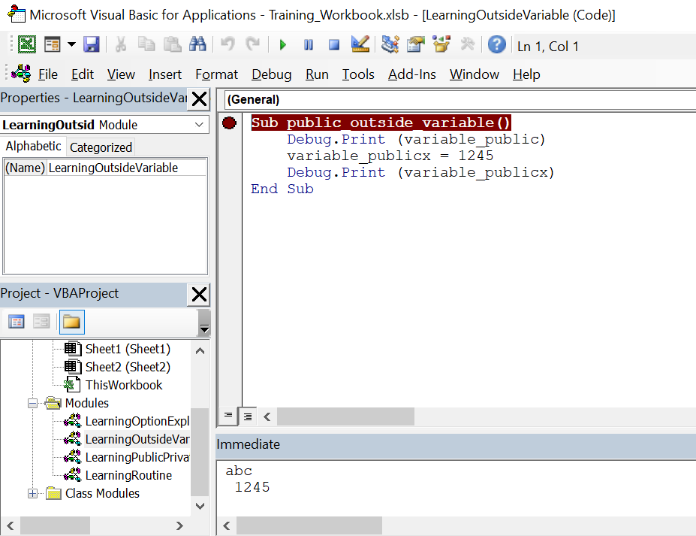
J. Public Variables “Public Variables” in VBA, as the name suggests, are variables that are declared to use publicly for all the macros
we write in the same module and different modules. So, when one declares the variables at the start of any Macro are called
“public variables” or “global variables.”
Observe variable is transferable to another module

Slide 17
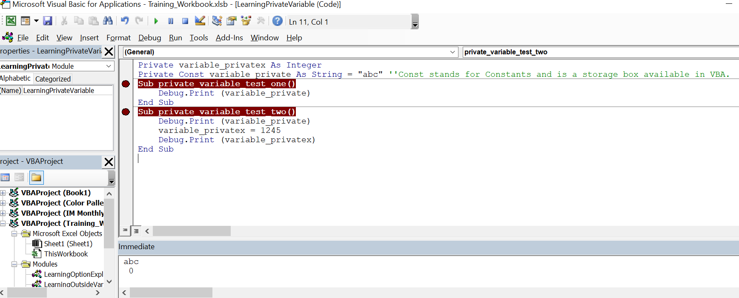
K. Private variables
Private variables Can be used only by procedures in the same module. When used at the module level,
the Dim statement is equivalent to the Private statement. You might want to use the Private statement to
make your code easier to read and interpret.

Slide 18
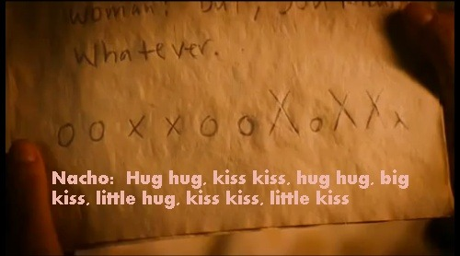
L. Conditional Statements
Some how look’s like this
This is the true logical symbol <>, >, <, = , OR, AND
Conditional Statements
A. Logical Operator
a.1. < Less Than
Example: 42 < 32 this is False
22 < 69 this is True
a.2. > Greater Than
Example: 11 > 89 this is False
66 > 22 this is True

Slide 19
a.3. = Equal
Example: 27 = 37 this is False
” young” = “old” this is False
99 = 99 this is True
a.6 <> Not: Example: 37 <> 47 this is True
“Pickle” <> “Rick” this is True
a.4. AND: Both statement should be True, if one is false then everything is false.
Example: 42 < 32 AND 66 > 22 this is False 66 > 22 AND 22 < 69 this is True
a.5. OR: If one of the two were false, the outcome would be true; but, if both were wrong, the result would be false. Example: 42 < 32 AND 66 > 22 this is True 66 < 22 AND ” young” = “old” this is False
A. IF Condition (Macro/VBA)
a.1. IF
a.2. IF and End IF
a.3. IF, Else, End IF
a.4. IF, Else If, Else, End IF
B. Select Case (Macro/VBA) b.1. Select Case and End Select.

Slide 20
30 mins review

Slide 21
Knowledge Check Quiz
5 Questions : )

